Slide 1
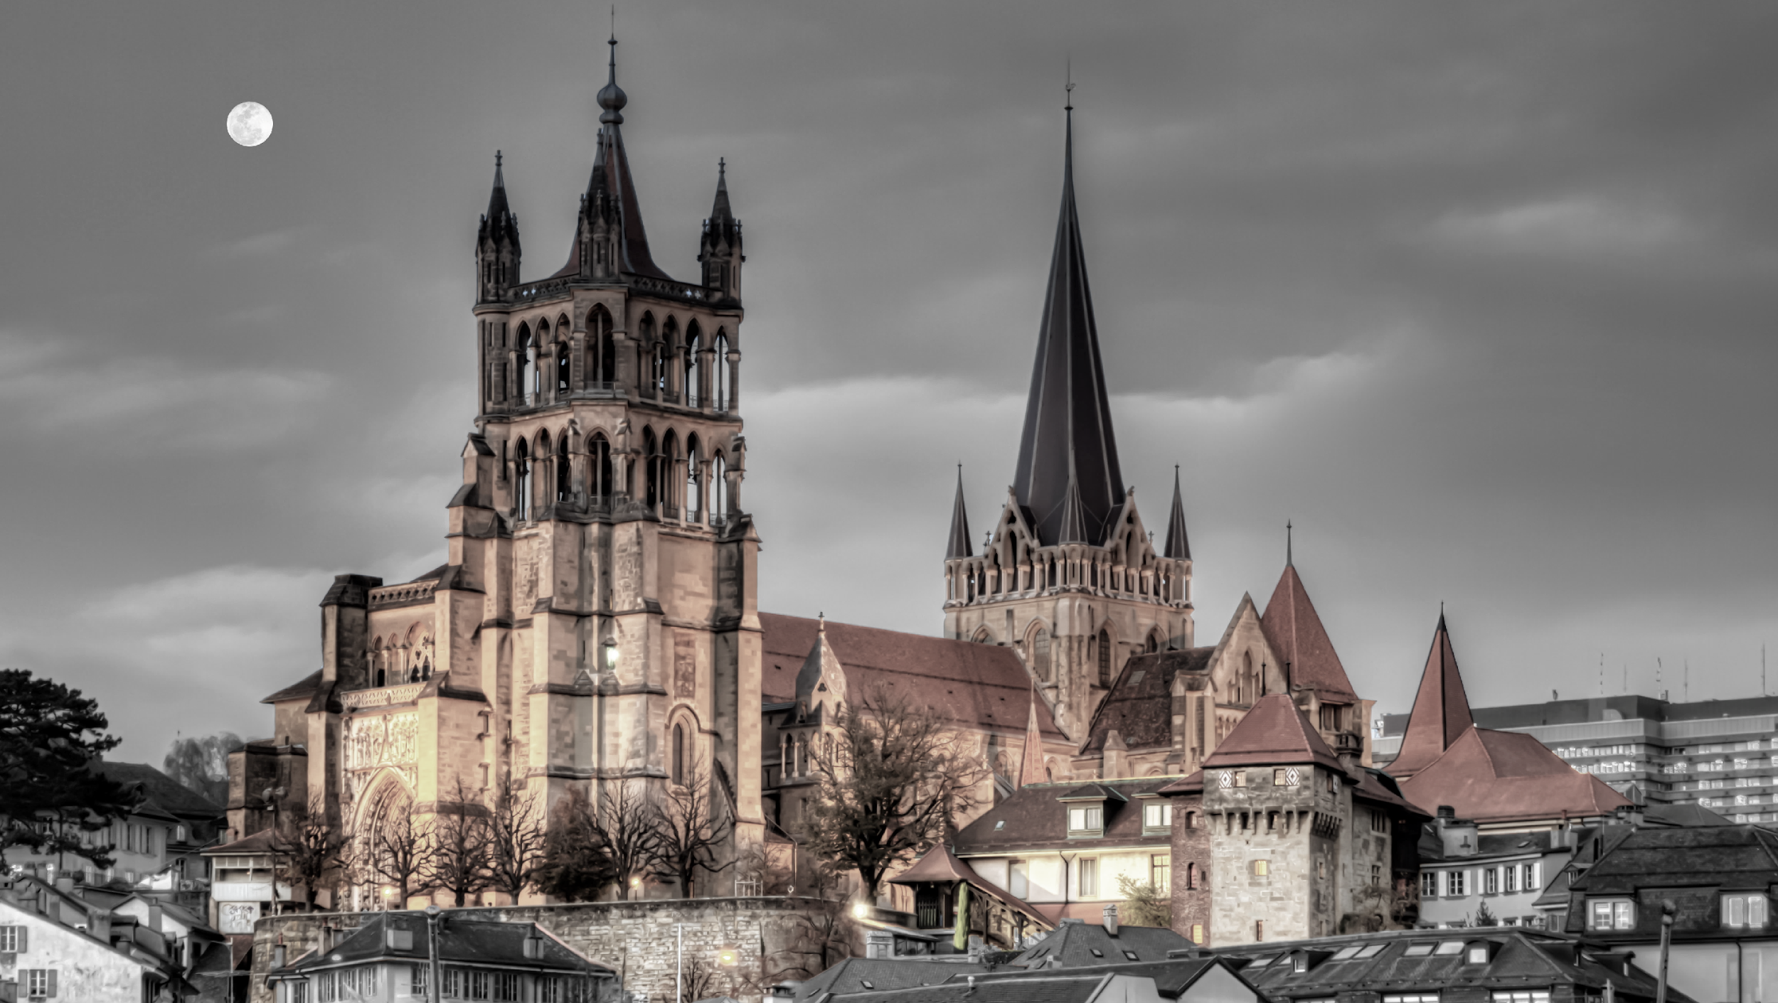



Français ▼
Cathédrale de Lausanne:
Centre d’Informations digitales
Site Web de la Cathédrale
Le 750 ème de la cathédrale
La Cathédrale Immersive
Image credit @ Elenarts

Slide 2
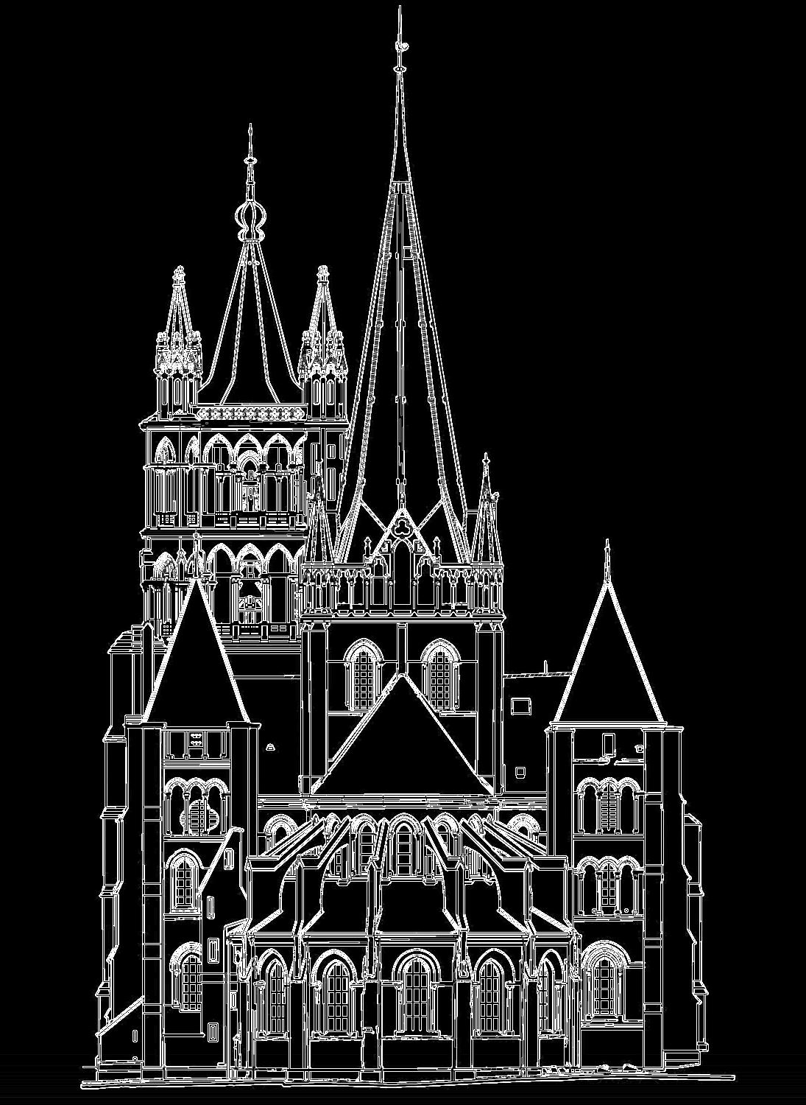


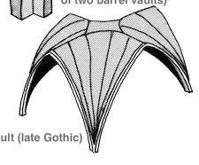
Français ▼
La Cathédrale Immersive:
Menu principal
Molasse et sa dégradation
Stratégies de conservation
Les voûtes de la cathédrale
…
Retour
Image Credits @AMSLER DOM architectes
Notes:
(can be mentioned that the conservation part is still in construction)

Slide 3
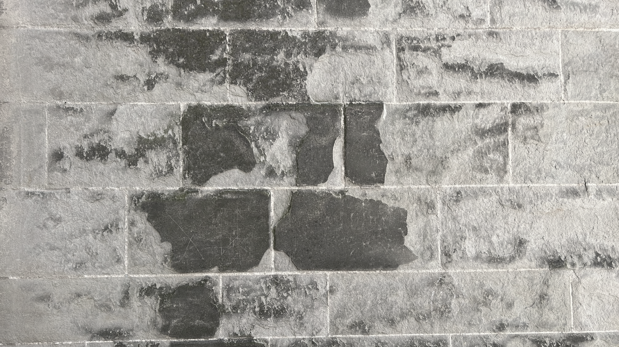

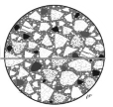


English ▼
The Immersive Cathedral
Molasse and its weathering
The cathedral of Lausanne was built with a local molasse sandstone, that is particlarly sensitve to water.
You may obtain directly here information on that stone as well as on its weathering by clicking on the corresponding buttons
You may also go directly to an interactive discovery App to use as you walk around the cathedral.
The Molasse sandstone
Weathering of Molasse
Interactive discovery
Back
Notes:
The app is being designed to explore different themes related to the conservation of historic structures.

Slide 4
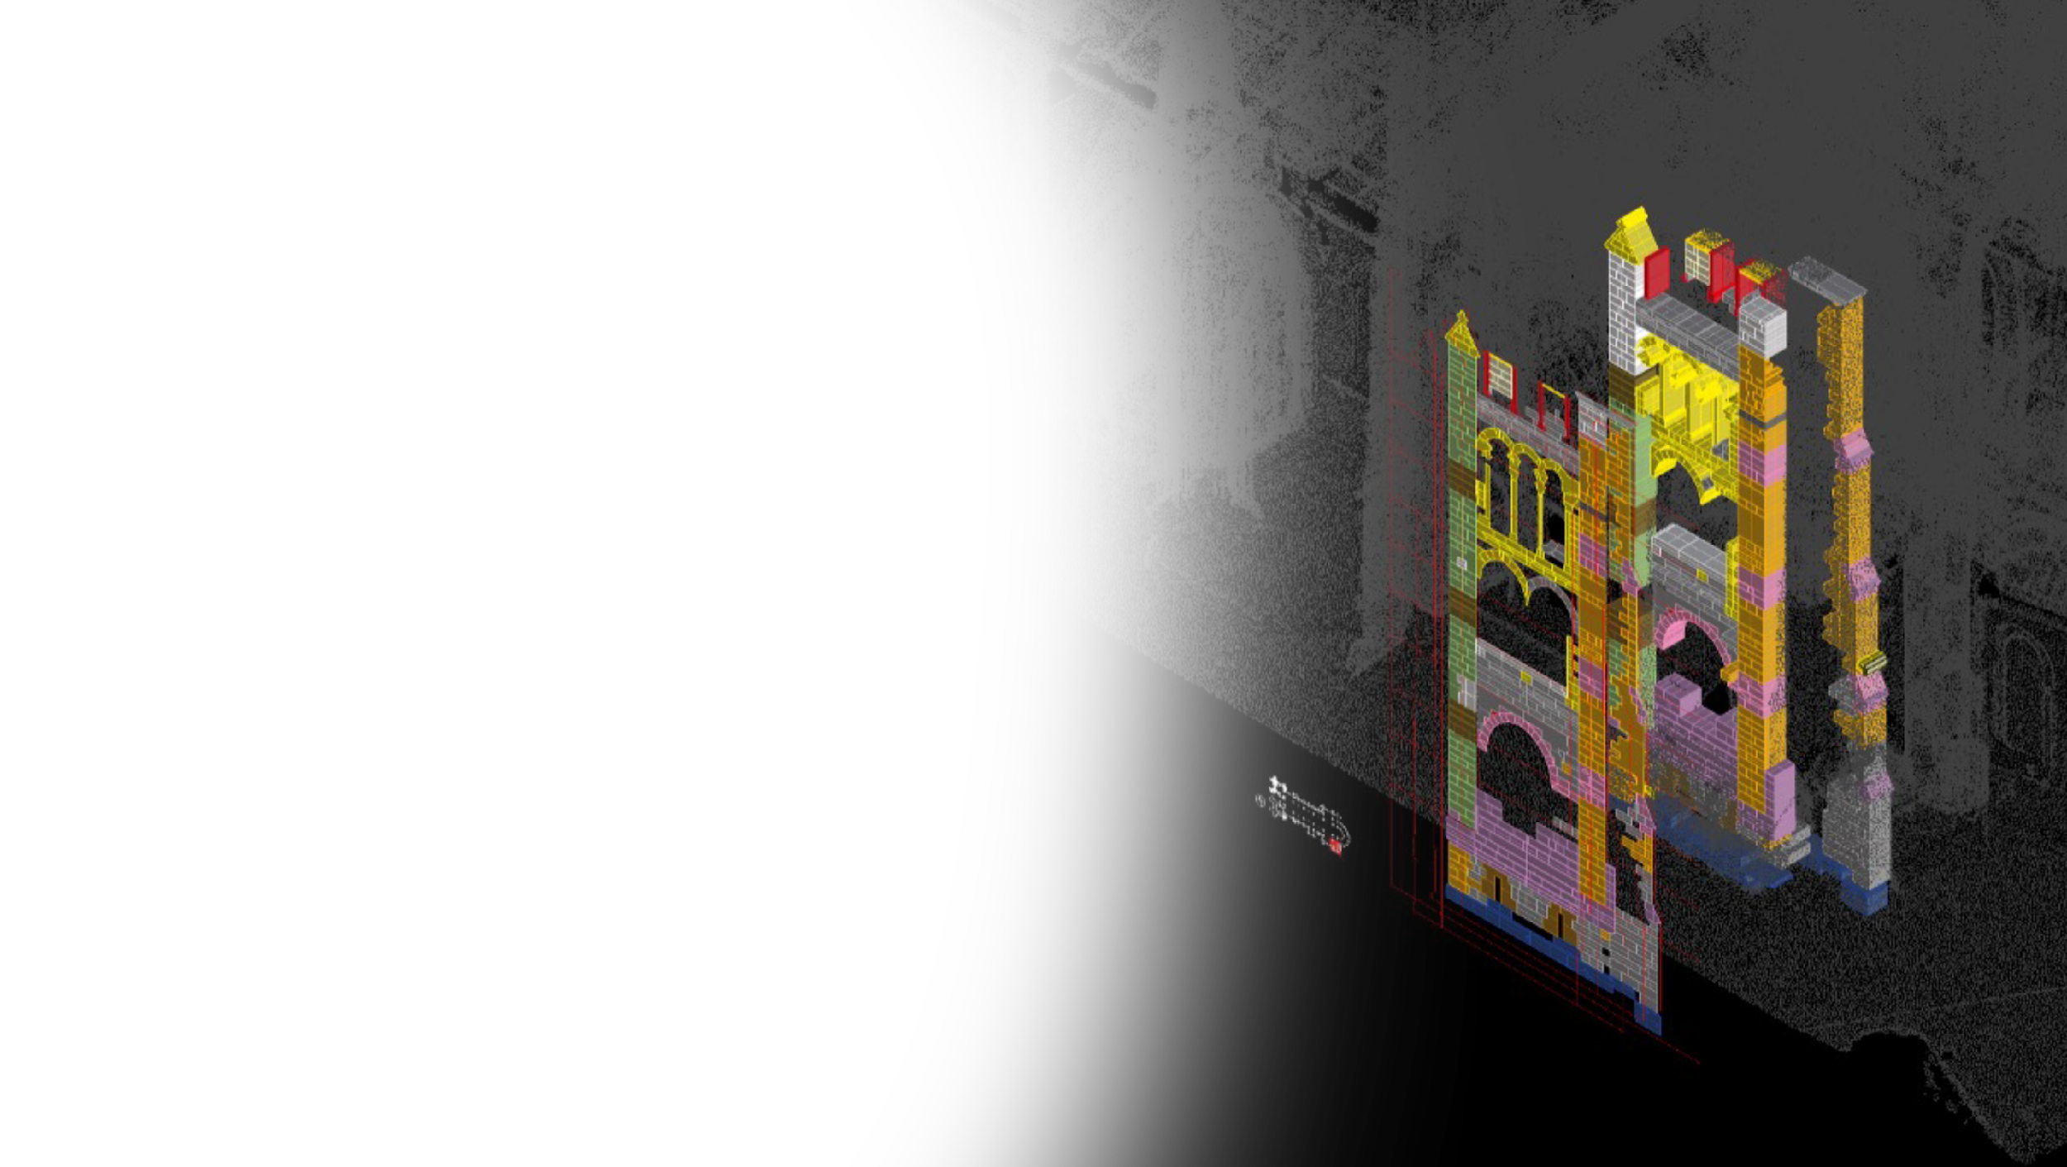
English ▼
Stones of the Cathedral
The Lausanne Cathedral is built from a variety of stones originating from different quarries all around Switzerland and some parts of Germany.
During the 19th century, the regional molasse sandstone of exposed architectural elements of the Cathedral was replaced with limestones and “harder” sandstones from the wider region of the canton Vaud.
In the 20th century, due to the scarcity of regional quarries, the general substitution of local molasse sandstone for maintenance and restoration became common practice. A variety of replacement sandstones from Fribourg, Bern, Zug, and Hannover (Oberkirchen, Germany) were utilized in its place
< GO TO INTERACTIVE LEARNING >
Back
Notes:
With interactive learning at its heart, the app is a mixture of quizzes and prompts encouraging the users to observe the structure around them
Some example quizzes and modules about the stones of the Cathedral are shown in the upcoming slides

Slide 5
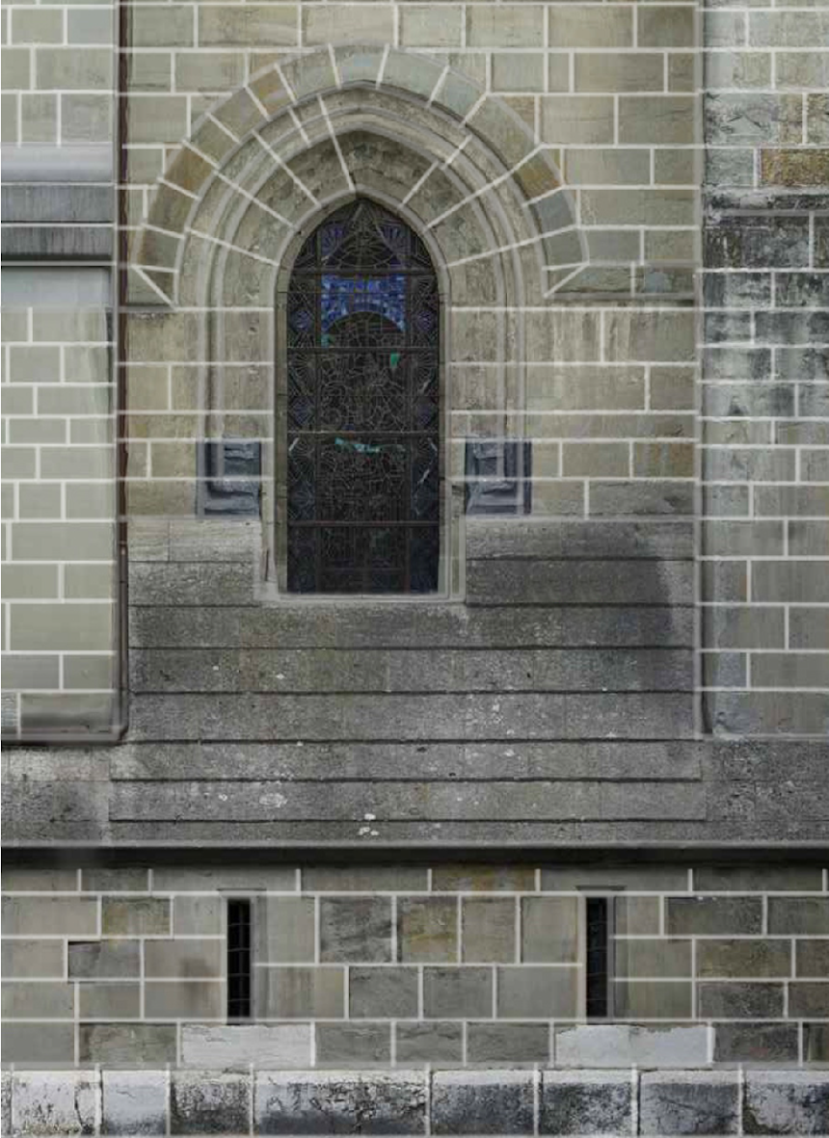
English ▼
The Immersive Cathedral
Can you identify the oldest stone in the facade?
>
Back
Image credit @Archeotech

Slide 6
English ▼
The Immersive Cathedral
Can you identify the oldest stone in the facade?
Correct!
The oldest stone type of the cathedral is Molasse Grise de Lausanne which was placed in the 12th Century CE.
Let’s learn more about it…
>
Back
Image credit @Archeotech

Slide 7
English ▼
The Immersive Cathedral
Molasse Grise de Lausanne
It is a molassic sandstone from Lausanne and was placed in the Cathedral in the 12th Century CE (Gothic period).
It is a type of sedimentary stone which is predominant on the south tower of the Transept. This sandstone most likely came from the nearby quarries.
This stone is particularly sensitive to water due to the presence of swelling clays.
< MORE INFORMATION >
>
Back
Image credit @Archeotech

Slide 8
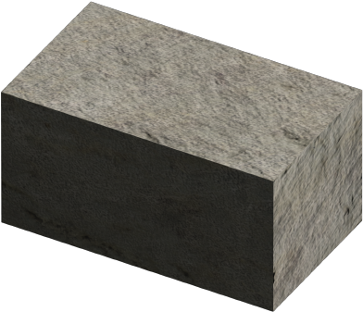
English ▼
The Immersive Cathedral
Molasse Grise de Lausanne
< CLICK TO LEARN ABOUT MOLASSE SANDSTONE>
>
Back
Image credit @Archeotech

Slide 9
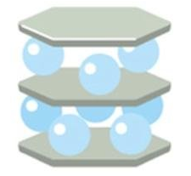
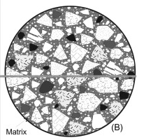


English ▼
Molasse Sandstone
The Swiss Molasse rock formation stretches north of the Alps from the Lake Léman region in the west of Switzerland to the Constance Lake in the east. It comprises a variety of calcite-bound sandstones, which can contain swelling clays. As part of this formation, the “Molasse grise de Lausanne” was extracted right outside the medieval city center and employed to erect the Lausanne Cathedral.
Over the centuries, sandstones of the same typology were brought in from different local quarries distributed around the medieval centre and employed for modification and maintenance works at the Cathedral.
< CONTINUE >
Geologicial information
Properties of Molasse
Types of Stones used
Interactive tour
Back

Slide 10

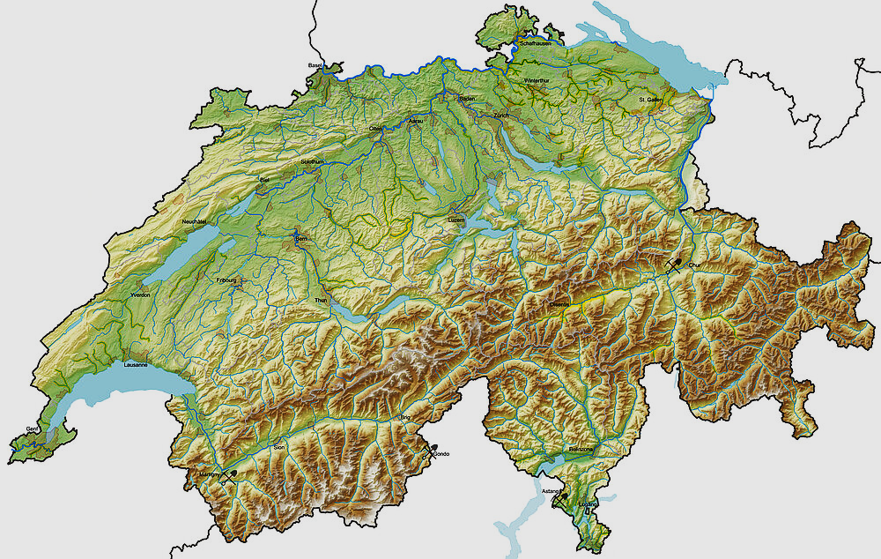
Molasse sandstone
Geological information
English ▼
The geology of Switzerland covers the Central Alps, a segment of the Alpine chain located between the Western Alps of France and Italy and the Eastern Alps of Italy, Austria and Germany. In this segment the Alpine chain is particularly narrow, yet it contains all the major tectonic units and exhibits landmark landscapes and landforms for which the Alps are known.
To the north, the Swiss Plateau extends from Lake Geneva to Bern, Zürich, and Lake Constance tapering off from around 600 to 400 m a.s.l. This plateau corresponds to what is called the Molasse Basin.
Click on the map to learn more about the different Molasse, the quarries and their characteristics
< CONTINUE >
Back
Notes:
Specific information about the Molasse basin and the type of stone

Slide 11
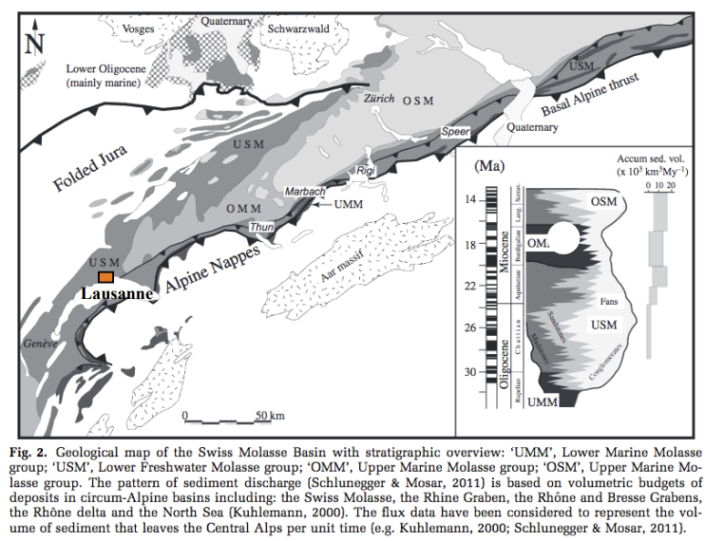
Molasse sandstone
English ▼
The Molasse facies result from the alteration and erosion of the Alps during the Alpine orogeny and are made up of sands of particle size variable (from fine to coarse), and of mineralogy also variable (quartz, feldspars, with more than or less micas) cemented with calcite.
The geological processes involved in the formation of the Molasse Basin date back to the Oligocene and Miocene eras.
Four main groups can be identified according to the sedimentation conditions involved (marine or freshwater condition).
Show the quarries
Back
Notes:
The app is developed to be explored and additional info are displayed as pop ups only if requested.
Click on Four main group

Slide 12
Molasse sandstone
English ▼
Molasse Grise de Lausanne
This facies of the Aquitanian age is deposited in the southern part of the Swiss plateau in the USM geological unit (Lower Freshwater Molasse).
The depositional environment is continental, in a low-relief floodplain environment, associated with forests, swamps and mean-shaped rivers.
This rock type varies in color from grey to blue, with some yellow variegation. It has a medium to coarse grain size and consists of quartz, potassium feldspars, plagioclases, calcite, and occasionally dolomite, pyrite, and goethite.
This is the main facies used on Lausanne Cathedral, including the south tower of the transept. You will know more about its use in the cathedral in the next section.
Show the quarries
Back
Notes:
The map display the results of the petrographical campaign conducted by UIL about the molasse used on the cathedral and can be structured to provide more insights

Slide 13
Molasse sandstone
English ▼
Molasse of Ursy
This facies, to which the name of Ursy molasse is attributed according to the archives, is a facies with flat stratifications alternating levels with fine grain size and coarse levels. This grey-green facies has a purplish-pink patina.
This facies is found only in the basal part of the south-east buttress of the east façade.
You will know more about its use in the cathedral in the next section.
Show the quarries
Back

Slide 14
Molasse sandstone
English ▼
Molasse of Ursy
This facies, to which the name of Ursy molasse is attributed according to the archives, is a facies with flat stratifications alternating levels with fine grain size and coarse levels. This grey-green facies has a purplish-pink patina.
This facies is found only in the basal part of the south-east buttress of the east façade.
You will know more about its use in the cathedral in the next section.
Show the quarries
Back

Slide 15
Molasse sandstone
English ▼
Molasse of Ursy
This facies, to which the name of Ursy molasse is attributed according to the archives, is a facies with flat stratifications alternating levels with fine grain size and coarse levels. This grey-green facies has a purplish-pink patina.
This facies is found only in the basal part of the south-east buttress of the east façade.
You will know more about its use in the cathedral in the next section.
Show the quarries
Back

Slide 16
English ▼
Molasse Sandstone
The Swiss Molasse rock formation stretches north of the Alps from the Lake Léman region in the west of Switzerland to the Constance Lake in the east. It comprises a variety of calcite-bound sandstones, which can contain swelling clays. As part of this formation, the “Molasse grise de Lausanne” was extracted right outside the medieval city center and employed to erect the Lausanne Cathedral.
Over the centuries, sandstones of the same typology were brought in from different local quarries distributed around the medieval center and employed for modification and maintenance works at the Cathedral.
< CONTINUE >
Geologicial information
Properties of Molasse
Types of Stones used
Interactive tour
Back
Notes:
Extra text:
During the 19th century, the regional molasse sandstone of exposed architectural elements of the Cathedral was replaced with limestones and “harder” sandstones from the wider region of the canton Vaud (Niggli 1915, 377). In the 20th century, due to the scarcity of regional quarries, the general substitution of local molasse sandstone for maintenance and restoration became common practice. A variety of replacement sandstones from Fribourg, Bern, Zug, and Hannover (Oberkirchen, Germany) were utilized in its place (Huguenin 2013) .
The Swiss Molasse sandstones quarried around Lausanne but also from other regions of the Swiss plateau have a sizeable capillary porosity, generally between 10 and 20 percent, with high capillary uptake rates, and contain high amounts of swelling clays when compared to other sandstones or building stones in general (Félix 1996). Depending on their nature, placing context and exposure, such varieties of Swiss Molasse sandstones, can extensively degrade, either by contour scaling or deep granular loss, within just a few decades. While this building material has been often unjustly declared “bad” in the past, it does represent a fragile system, which requires a refined understanding of its performance characteristics, thus, possible employment configurations and, consequentially and most importantly, its maintenance needs.

Slide 17
English ▼
The Immersive Cathedral
Can you identify a limestone on the facade?
>
Back
Image credit

Slide 18
English ▼
The Immersive Cathedral
Can you identify a limestone on the facade?
Correct!
This stone type is the Rudist limestone which was placed on the Cathedral in the 13th Century CE.
Let’s learn more about it…
>
Back
Image credit

Slide 19
English ▼
The Immersive Cathedral
Calcaire à rudistes
This limestone was placed in the cathedral in the 13th Century CE (Gothic period). Rudist limestone, found in the Jura ranges, is more resistant to weathering as compared to Molasse and therefore used at the base of the structure.
Fun fact: The origin of these stones is most likely the reuse of monuments from the Roman era.
< BACK >
>
Back
Image credit

Slide 20
English ▼
The Immersive Cathedral
Good work! You are now ready to explore the next section
Go back to the main menu…
>
Back
Image credit
Notes:
Similar information can be also find in the Interactive app.

Slide 21
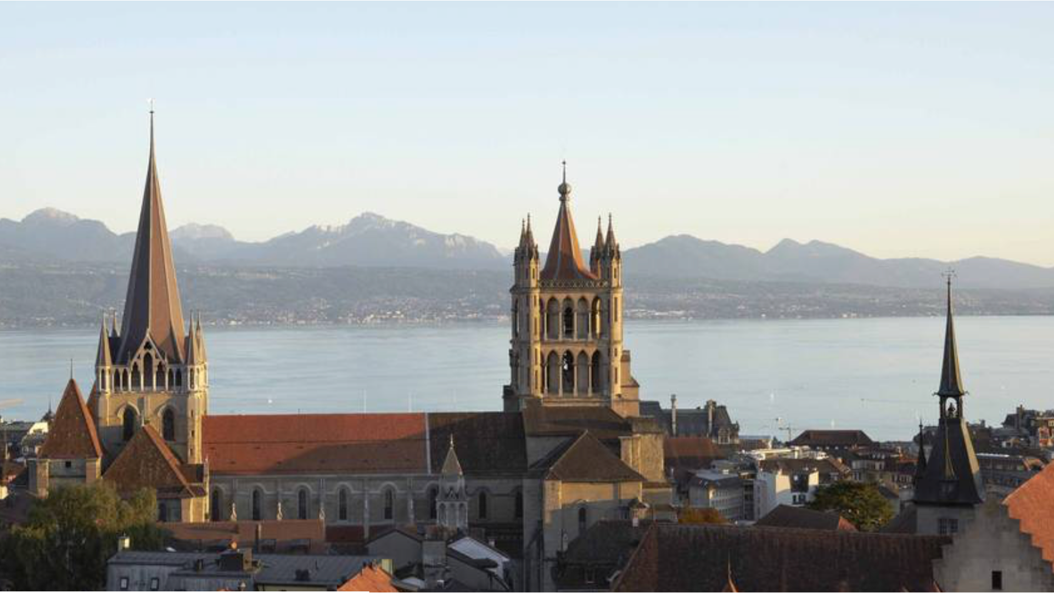
English ▼
The Immersive Cathedral
Molasse and its weathering
The cathedral of Lausanne was built with a local molasse sandstone, that is particlarly sensitve to water.
You may obtain directly here information on that stone as well as on its weathering by clicking on the corresponding buttons
You may also go directly to an interactive discovery App to use as you walk around the cathedral.
< CONTINUE >
The Molasse sandstone
Weathering of Molasse
Interactive discovery
Back
Image credit

Slide 22


English ▼
The Immersive Cathedral
Molasse and its weathering
The process of degradation is a complex system that involves different factors.
The weathering mechanisms are the physical/chemical processes involved in the degradation.
The degradation type (or patterns) refers to how damage manifest in a larger scale.
< CONTINUE >
Weathering mechanism
Degradation type
Back
Image credit
Notes:
The objective of the section is to explain the degradation mechanism dynamically, trying to make it understandable while highlighting the complexity of the phenomena and the different factors involved.
The intercorrelation of the concatenation of degradation pattern and weathering mechanism is an important and challenging divulgation topic that can enhance the curiosity of the public and automatically highlight the importance of the work of conservation and documentation.

Slide 23



English ▼
The Immersive Cathedral
Molasse and its weathering
Feeze thaw action
Water is involved in all types of mechanisms of stone weathering.
You can get further information on each of them by clicking on the corresponding buttons.
< CONTINUE >
Swelling clays
Salt crystallization
Atmospheric pollution
Biological attack
Back
Image credit
Notes:
In this section for each mechanism the scientific information can be obtained, for example, through short texts, images and schemes.

Slide 24
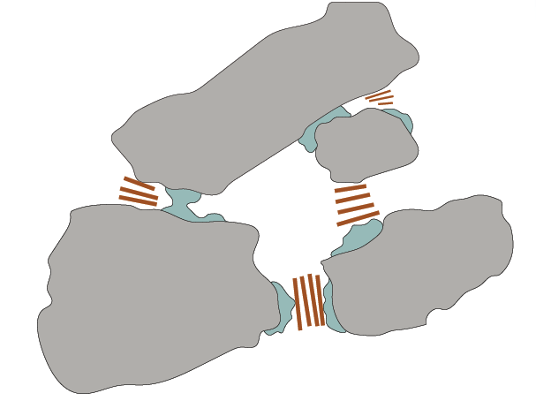
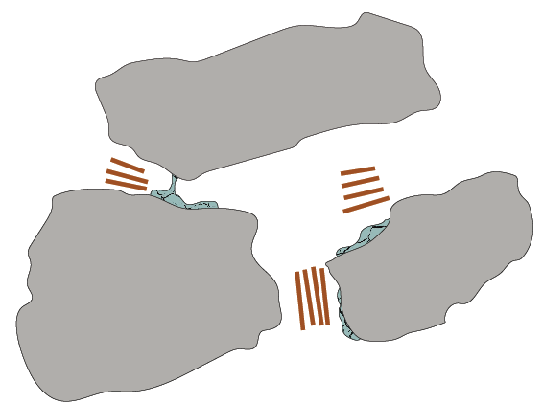
English ▼
Stone weathering by pollution
1/2: acid rain
Atmospheric pollution, particularly acid rains, has been a serious problem for the durability of Historic Buildings in the past.
Stones containing calcite were attacked due to the dissolutions of these minerals in contact with the acid solutions.
In the case of Molasse sandstone, the binder component (made of calcite) could have been affected, increasing the detachment of the grains in the stone’s microstructure.
< CONTINUE >
Swelling clays
Silica grains
Calcitic cement
Back
Image credit
Notes:
… atmospheric pollution and its effect on the sandstone….

Slide 25
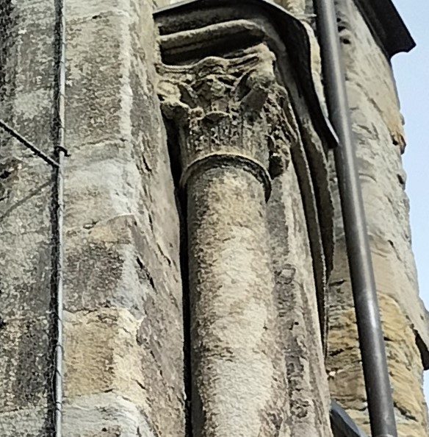
English ▼
Stone weathering by pollution
2/2: microparticles and dust
Another problem related to the pollution of the air, to whom effect was decreased in the last 30 years, is the presence of microparticles of dust from the combustion processes that deposit on the stones and/or are englobed in the efflorescence that are formed due to the crystallization of salts on the surface of the buildings.
This led to the formation of the so called “black crusts”
< CONTINUE >
Back
Image credit
Notes:
… as well as other phenomena associated

Slide 26
English ▼
The Immersive Cathedral
Weathering mechanisms
Feeze thaw action
Water is involved in all types of mechanisms of stone weathering.
You can get further information on each of them by clicking on the corresponding buttons.
< CONTINUE >
Swelling clays
Salt crystallization
Atmospheric pollution
Biological attack
Back
Image credit
Notes:
in the case of the swelling clay mechanism…

Slide 27
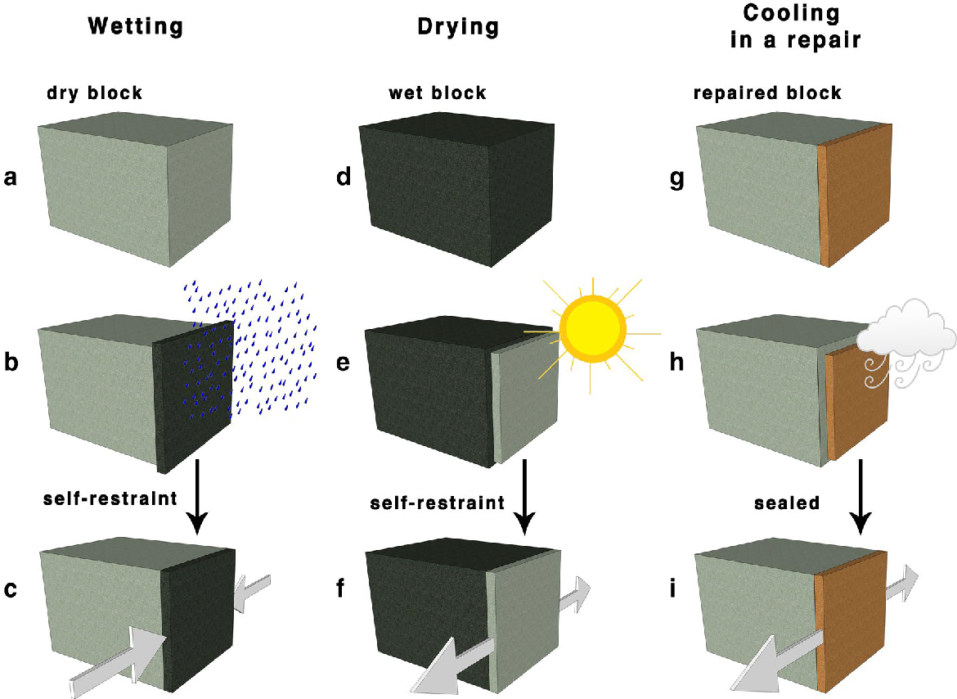



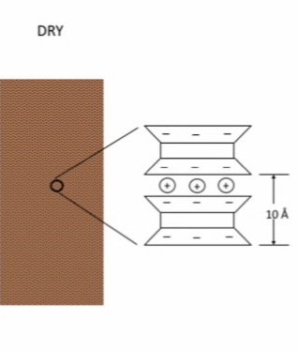
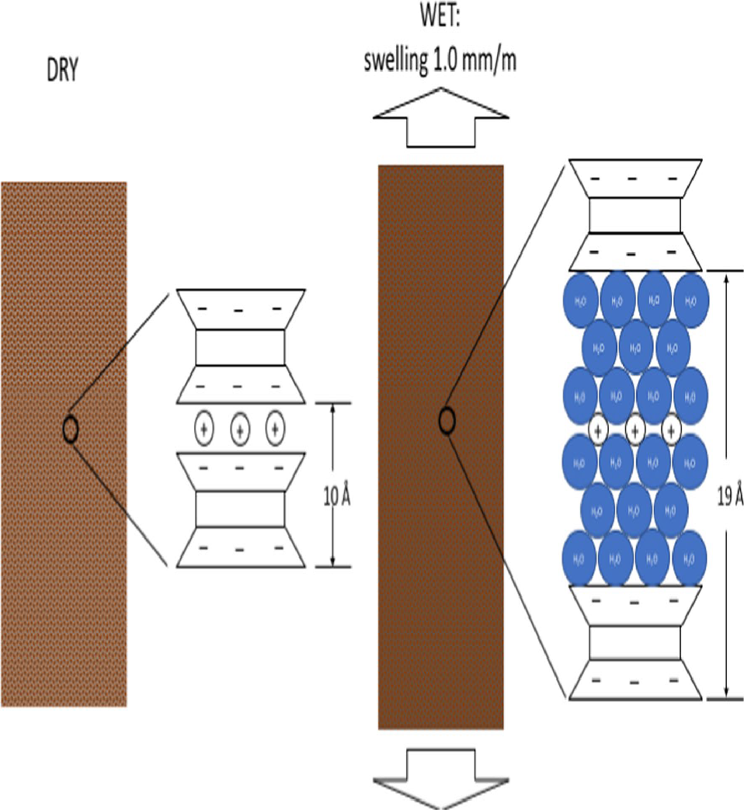

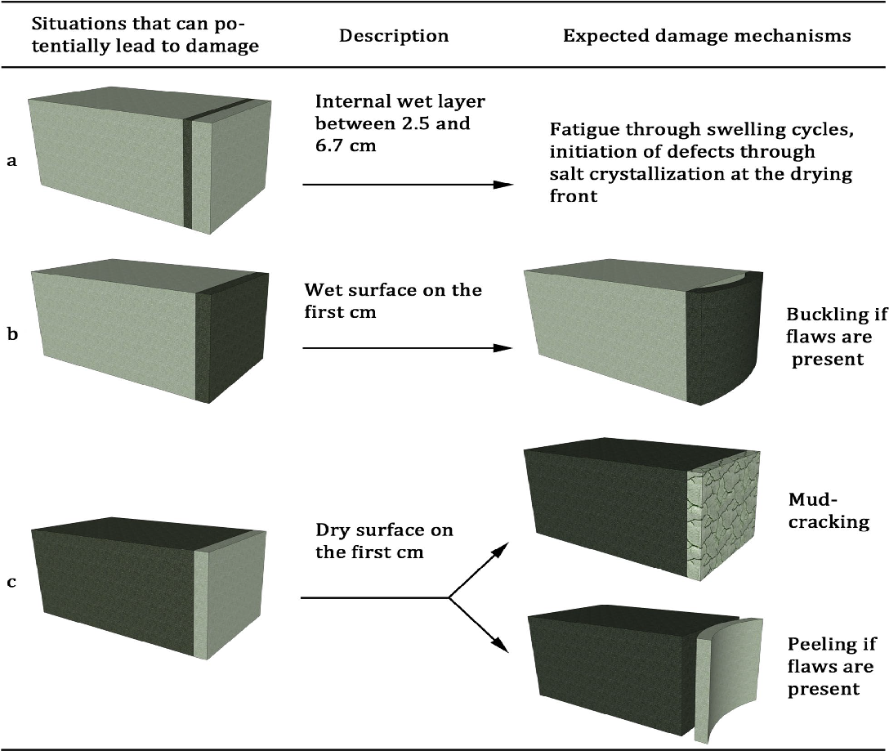
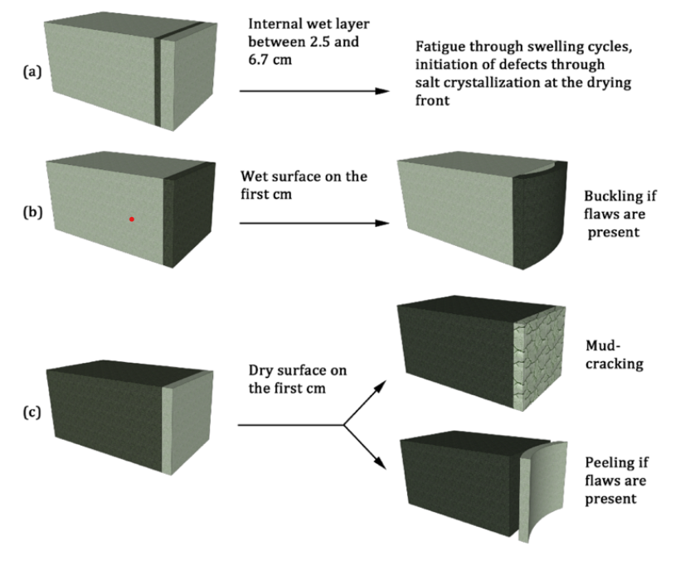
English ▼
Stone weathering by pollution
Swelling clays
Swelling clays, like smectite, are a particular type of clay that can absorb water and expand. They are part of the family of Phyllosilicates (or "sheet silicates"), a group of minerals that have a unique layered structure.
Imagine them as tiny, flat sheets stacked on top of each other like a deck of cards.
In the case of swelling clays, due to some particular asset of the layers, in contact with water, they have the ability to pull the water molecules in between their sheets, causing the entire stack to puff up or swell. The consequence is the swelling of the entire stone.
Wetting
Drying
dry block
wet block
The stone used in Lausanne Cathedral during the Middle Ages is Molasse sandstone.
Its microstructure consists of different siliceous materials bound together by a calcite-clay binder.
The presence of swelling clay determines the formation of stress in the material during wetting and drying due to rain. This stress, in the case of pre-existing cracks, can propagate them and cause scaling.
Go back to the Molasse sandstone section for more geological details.
water
Buckling
Peeling
Mud-cracking
Back
Image credit
Notes:
We can see how the app will include some additional info that can be displaced according to the users’ willing

Slide 28
English ▼
The Immersive Cathedral
Weathering mechanisms
Feeze thaw action
Water is involved in all types of mechanisms of stone weathering.
You can get further information on each of them by clicking on the corresponding buttons.
< CONTINUE >
Swelling clays
Salt crystallization
Atmospheric pollution
Biological attack
Back
Image credit
Notes:
Or through the use of video… (I liked what you said in the trial video)

Slide 29

English ▼
Stone weathering by freezing
1/4: Trapped Water
Freezing water in porous materials can cause damage by various mechanisms. The first and most dramatic is called “water entrapment.” It refers to a situation similar to that of a glass bottle filled with water and placed in a cooler. In other words, freezing occurs from all sides, the liquid is trapped, and the increase in molar volume from liquid water to ice causes the bottle to break.
Such situations are rare on monuments, with the possible exception of fine decorative elements previously saturated with water, as finials and fountains.
< CONTINUE >
QR
Code
Back
Image credit

Slide 30

English ▼
Stone weathering by freezing
2/4: Hydraulic Pressure
Another situation also related to the change in molar volume is called “hydraulic pressure”. It occurs when growing ice pushes the liquid water still present through the porous network. The flow resistance leads to a pressure that depends on the size of the pores and the distance over which the water is pushed.
For molasse, the pore size is large, which reduces this pressure. However, if these same stones are saturated with water, then the equivalent length of the saturated pores can be very large, which can lead to high hydraulic pressures if the cooling rate is fast enough.
< CONTINUE >
QR
Code
Back
Image credit

Slide 31
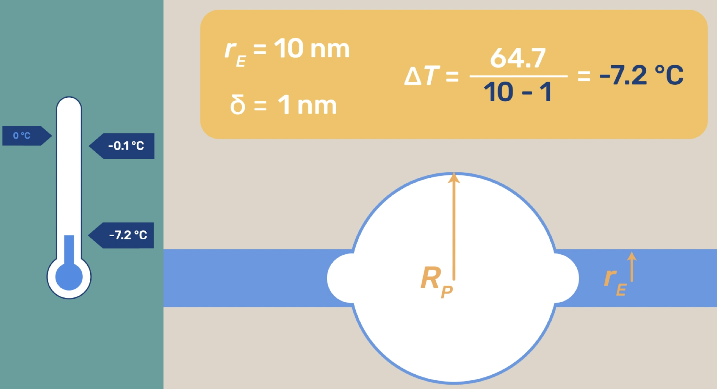
English ▼
Stone weathering by freezing
3/4 : Crystallization Pressure
Another situation in which frost can be damaging is the crystallization pressure. Under such conditions, low temperatures developed over long periods of time would be most damaging. Such situations are to be expected in colder climates than in Lausanne.
< CONTINUE >
QR
Code
Back
Image credit

Slide 32
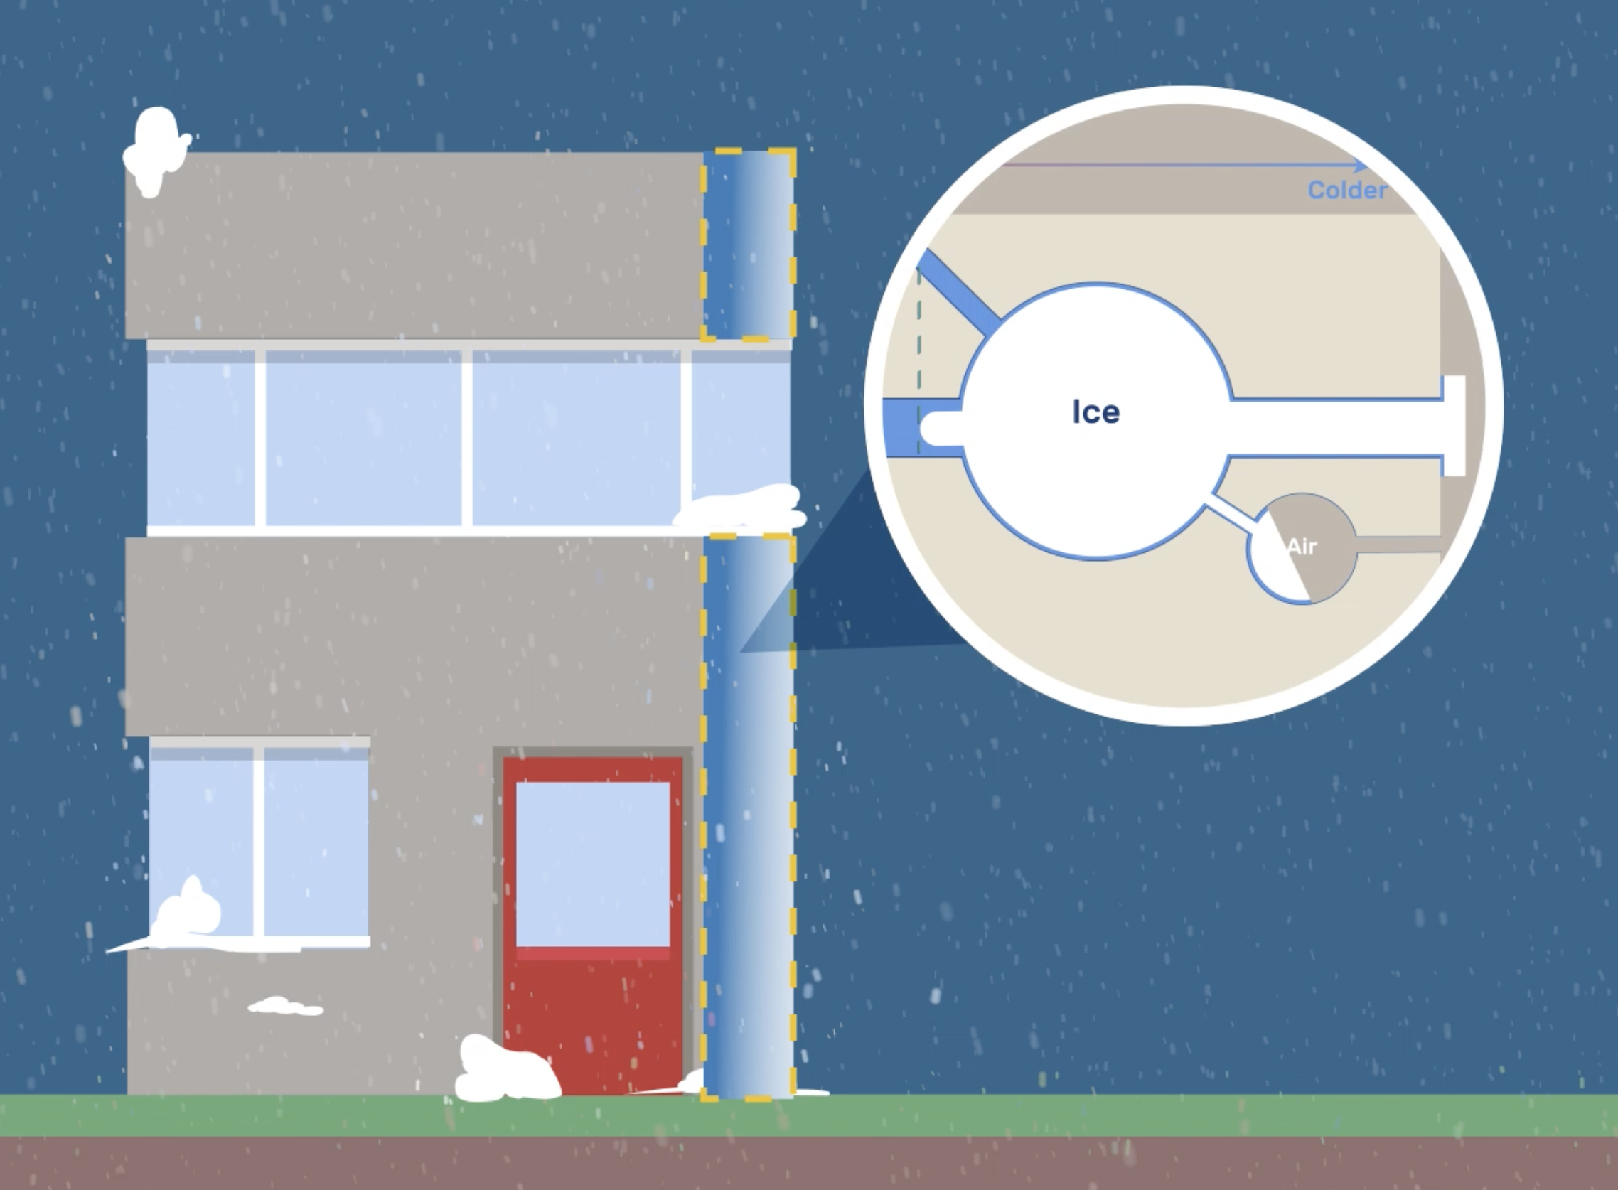
English ▼
Stone weathering by freezing
4/4: Temperature gradient
Coarse porous materials, such as molasse, can be damaged during freezing if a temperature gradient is sustained. Water can then move from an unfrozen region to feed the growth of ice trapped in the pores of a frozen region. This is analogous to frost heave but also can cause damage in sedimentary building stones and in geological settings.
Related situations can lead to forming ice lenses between a moist substrate (stone cores) and a surface subject to temperature variations (façade). The growth of such lenses can accelerate the detachment of pre-existing scales without the temperatures having to be very low.
< END >
QR
Code
Back
Image credit
Notes:
Extra text
. Ice lenses, however, only form in pre-damaged zones and do not play a significant role in damage initiation. In this respect, the consolidation of the weakened stone, along with some degree of hydrophobization, may, in principle, reduce the risk of frost damage. However, the extent of this would depend very much on local circumstances and cannot be assessed a priori.

Slide 33
English ▼
The Immersive Cathedral
Weathering of Molasse
The process of degradation is a complex system that involves different factors.
The weathering mechanisms are the physical/chemical processes involved in the degradation.
The degradation types (or patterns) refer to how damage manifests on a larger scale.
< CONTINUE >
Weathering mechanism
Types of degradation
Back
Image credit

Slide 34
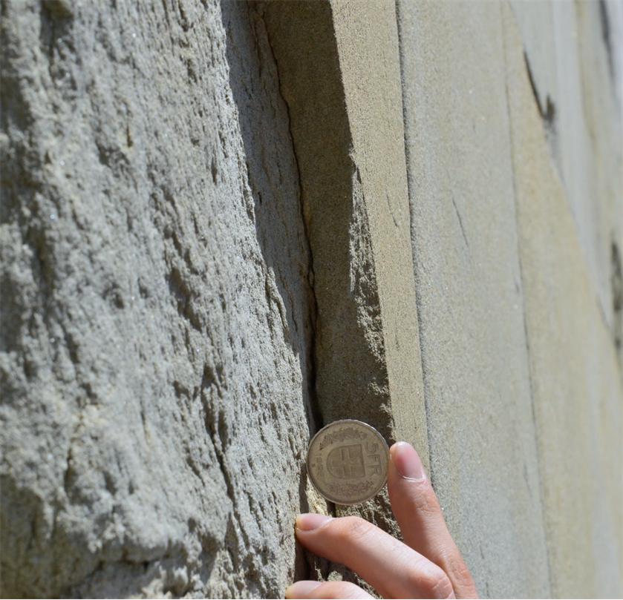
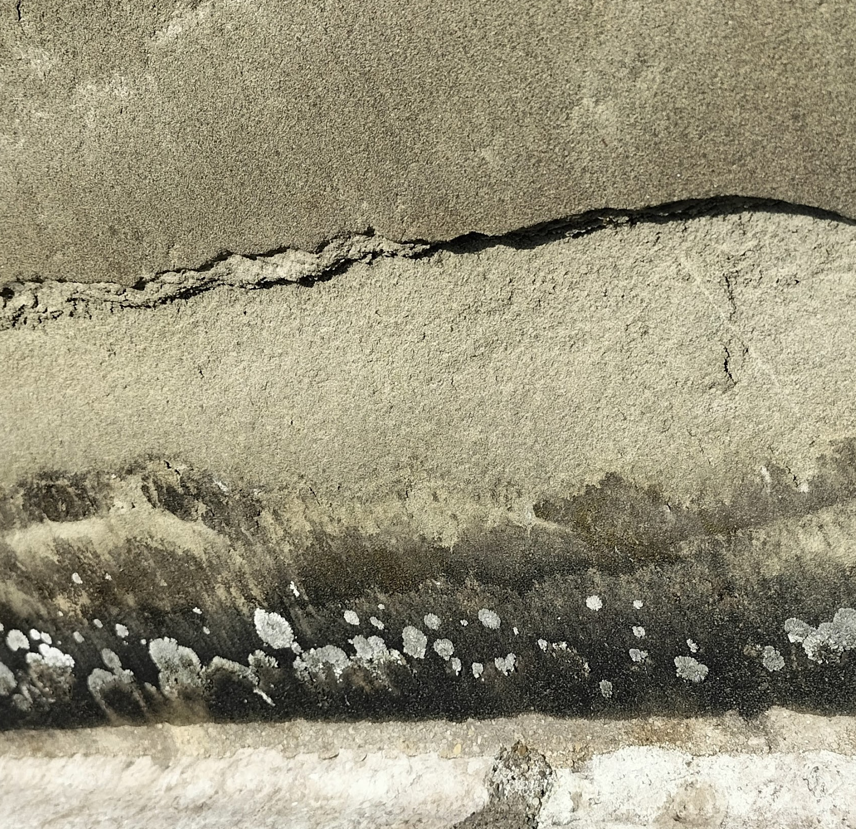
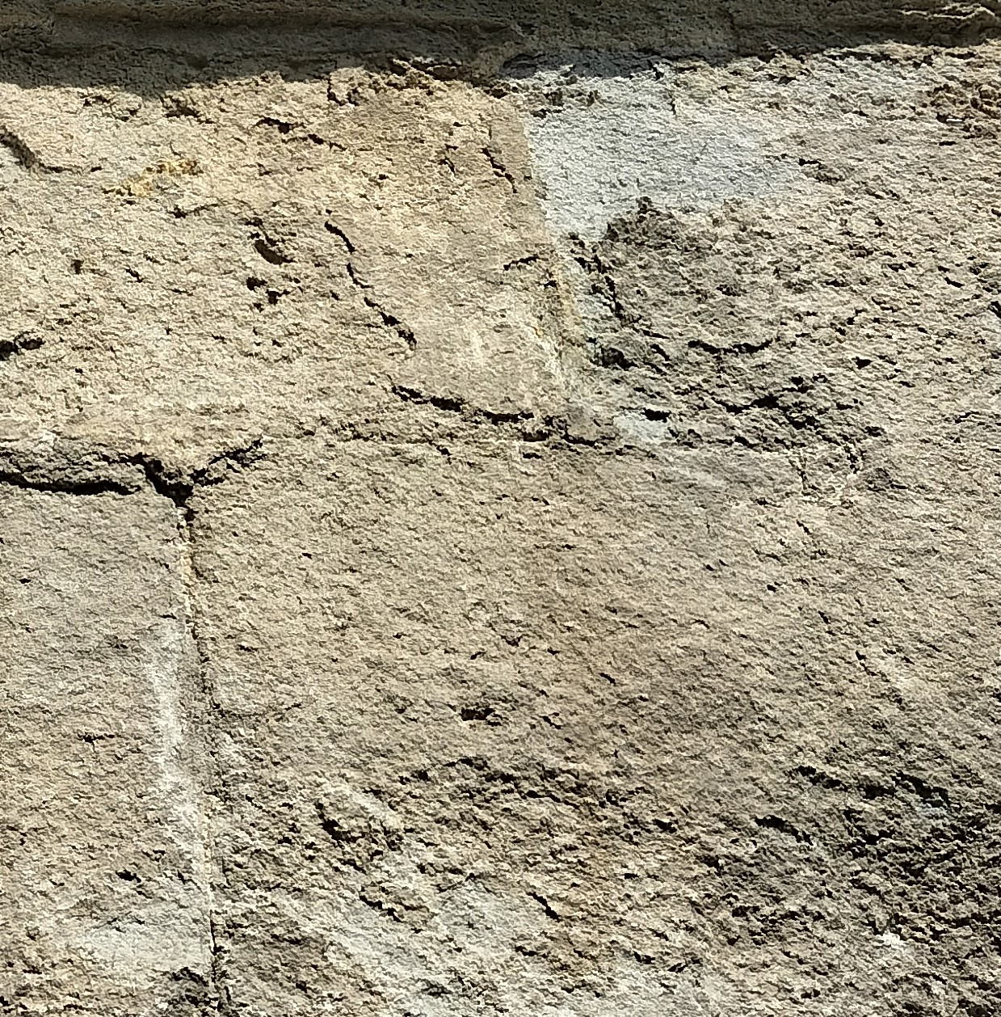
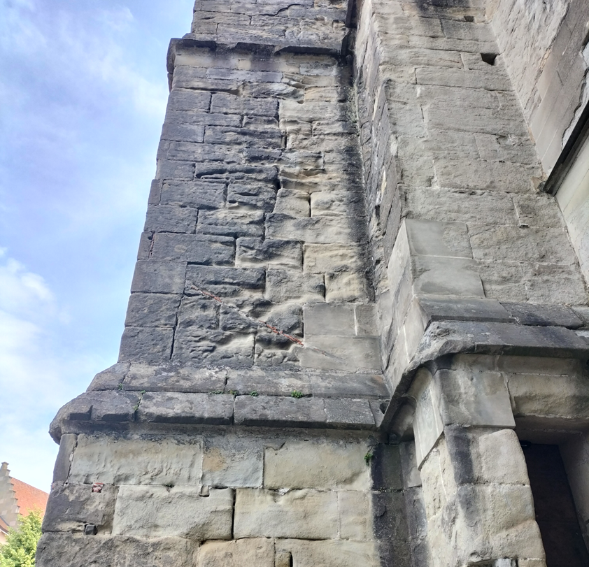


English ▼
The Immersive Cathedral
Weathering of Molasse – types of degradation
Example of degradation patterns on the Lausanne Cathedral
The major degradation patterns observed on the cathedral can be classified according these 4 classes
Scaling Biodeterioration Black crust Sanding
The different weathering mechanisms do not always have an univocal correlation with the degradation pattern observed.
These are strongly related to the micro-climate the stone is subjected to and in consequence their position in the building.
The compresence in the same point of different degradation pattern can lead their identification difficult.
Degradation examples
Localization of the decays
Back
Image credit
Notes:
The passage to the degradation type is done by giving the visual information, the use of “speaking” images ferry toward the more specific knowledge of the conservators and architects involved in the preservation.

Slide 35
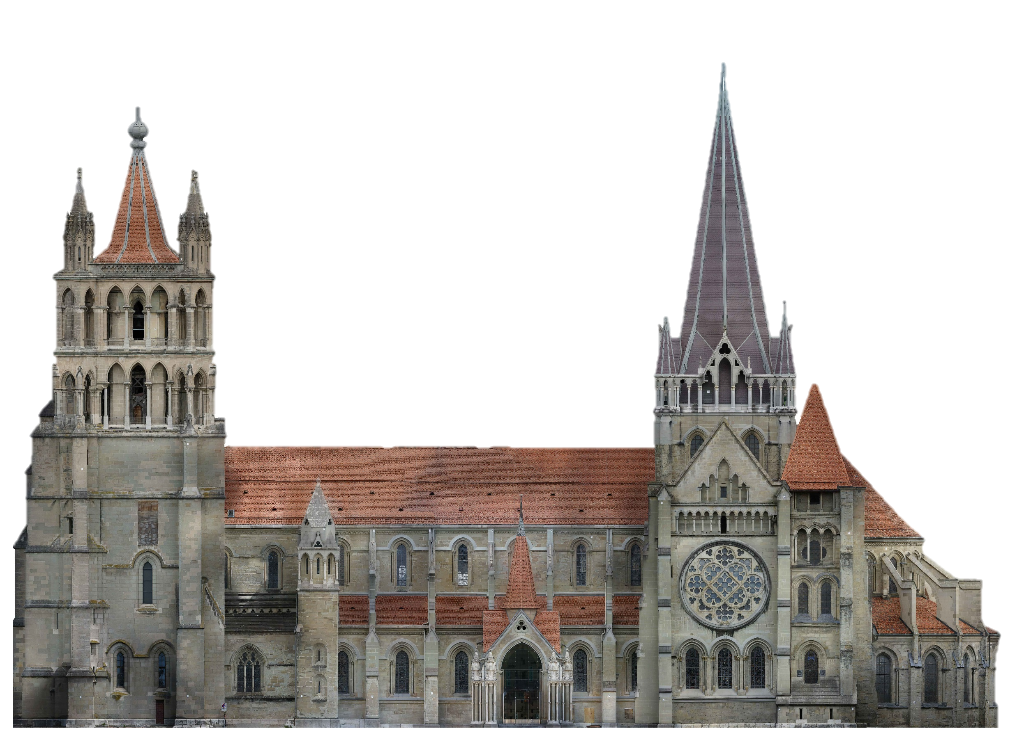
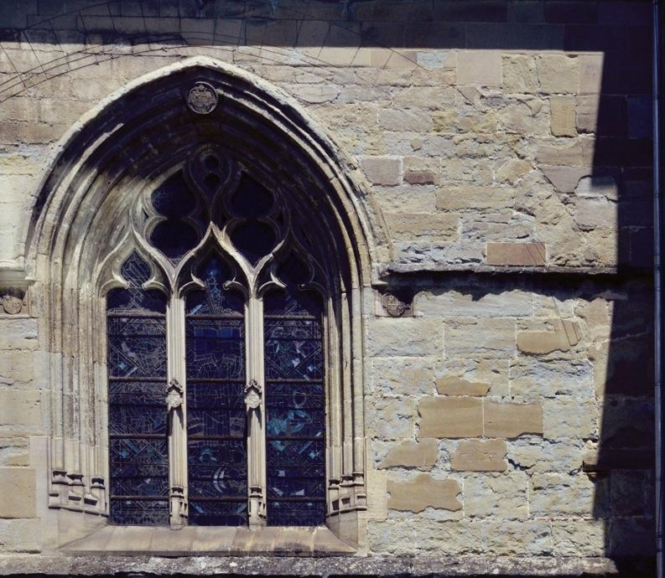
English ▼
The Immersive Cathedral
Weathering of Molasse – types of degradation
How many type of degradation can you find in the area?
There are areas of the Cathedral more affected by a certain type of degradation, but also small difference in the geometry of the building can make a difference. In the red area we can find a good example, click on it to discover more…
1
2
3
The different weathering mechanisms do not always have an univocal correlation with the degradation pattern observed.
These are strongly related to the micro-climate the stone is subjected to and in consequence their position in the building.
Degradation examples
Localization of the decays
>
Back
Image credit
Notes:
In the context of localization of the degradation, the introductory section underscores the significance of the stone's placement within the building and its correlation with the prevailing microclimate conditions.
The interactivity will include some small quizzes.

Slide 36
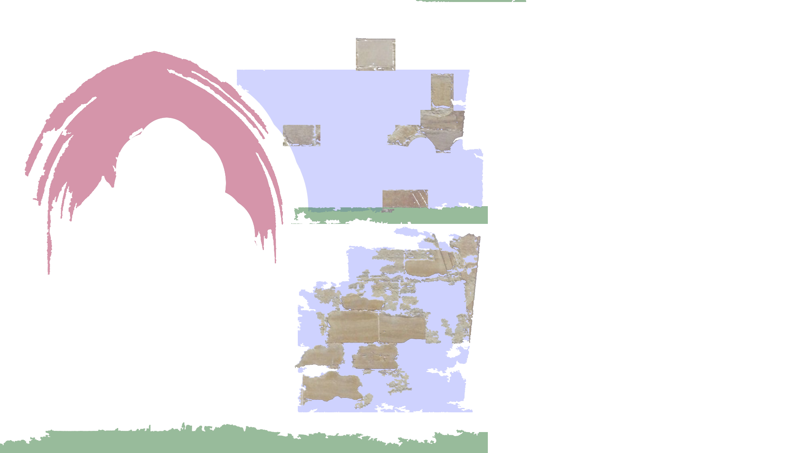


English ▼
The Immersive Cathedral
Weathering of Molasse – types of degradation
There are areas of the Cathedral more affected by a certain type of degradation, but also small difference in the geometry of the building can make a difference. In the red area we can find a good example, click on it to discover more…
How many type of degradation can you find in the area?
1
2
3
The different weathering mechanisms do not always have an univocal correlation with the degradation pattern observed.
These are strongly related to the micro-climate the stone is subjected to and in consequence their position in the building.
Degradation examples
3 is the right answer!
Let’s discover them together…
Localization of the decays
>
Back
Image credit

Slide 37

English ▼
The Immersive Cathedral
Weathering of Molasse – types of degradation
Biodeterioration
In the areas more hit by the rain or where water percolates, the microorganisms such as fungi and musses find their natural humid environment to proliferate.
The resultant damage is not extremely dangerous for stone preservation but can create unpleasant aesthetic drawbacks.
The different weathering mechanisms do not always have an univocal correlation with the degradation pattern observed.
These are strongly related to the micro-climate the stone is subjected to and in consequence their position in the building.
>
Back
Image credit
Notes:
The acquisition of information before the external exploration of the site is a common strategy used in divulgation and education that prepare the ground for the more interactive and engaging part

Slide 38

English ▼
The Immersive Cathedral
Weathering of Molasse – types of degradation
Black crusts
Black crusts are classified as kind of crust developing generally on areas protected against direct rainfall or water runoff in urban environment.
Black crusts usually adhere firmly to the substrate. They are composed mainly of particles from the atmosphere, trapped into a gypsum (CaSO4.2H2O) matrix.
The different weathering mechanisms do not always have an univocal correlation with the degradation pattern observed.
These are strongly related to the micro-climate the stone is subjected to and in consequence their position in the building.
>
Back
Image credit

Slide 39
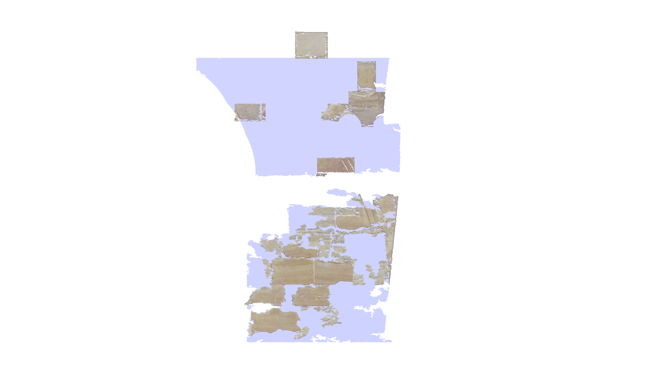
English ▼
The Immersive Cathedral
Weathering of Molasse – types of degradation
Scaling
Detachment of stone as a scale or a stack of scales, not following any stone structure and detaching like fish scales or parallel to the stone surface. The thickness of a scale is generally of millimetric to centimetric scale.
It can be observed in areas exposed both to rain and sun.
It represents the most challenging degradation pattern to evaluate, understand and restore.
The different weathering mechanisms do not always have an univocal correlation with the degradation pattern observed.
These are strongly related to the micro-climate the stone is subjected to and in consequence their position in the building.
>
Back
Image credit

Slide 40
English ▼
The Immersive Cathedral
Weathering of Molasse – types of degradation
You are now ready for the interactive tour.
Go out and test your knowledge
The different weathering mechanisms do not always have an univocal correlation with the degradation pattern observed.
These are strongly related to the micro-climate the stone is subjected to and in consequence their position in the building.
Interactive discovery
>
Back
Image credit
Notes:
Similar information can be also find in the Interactive app.

Slide 41
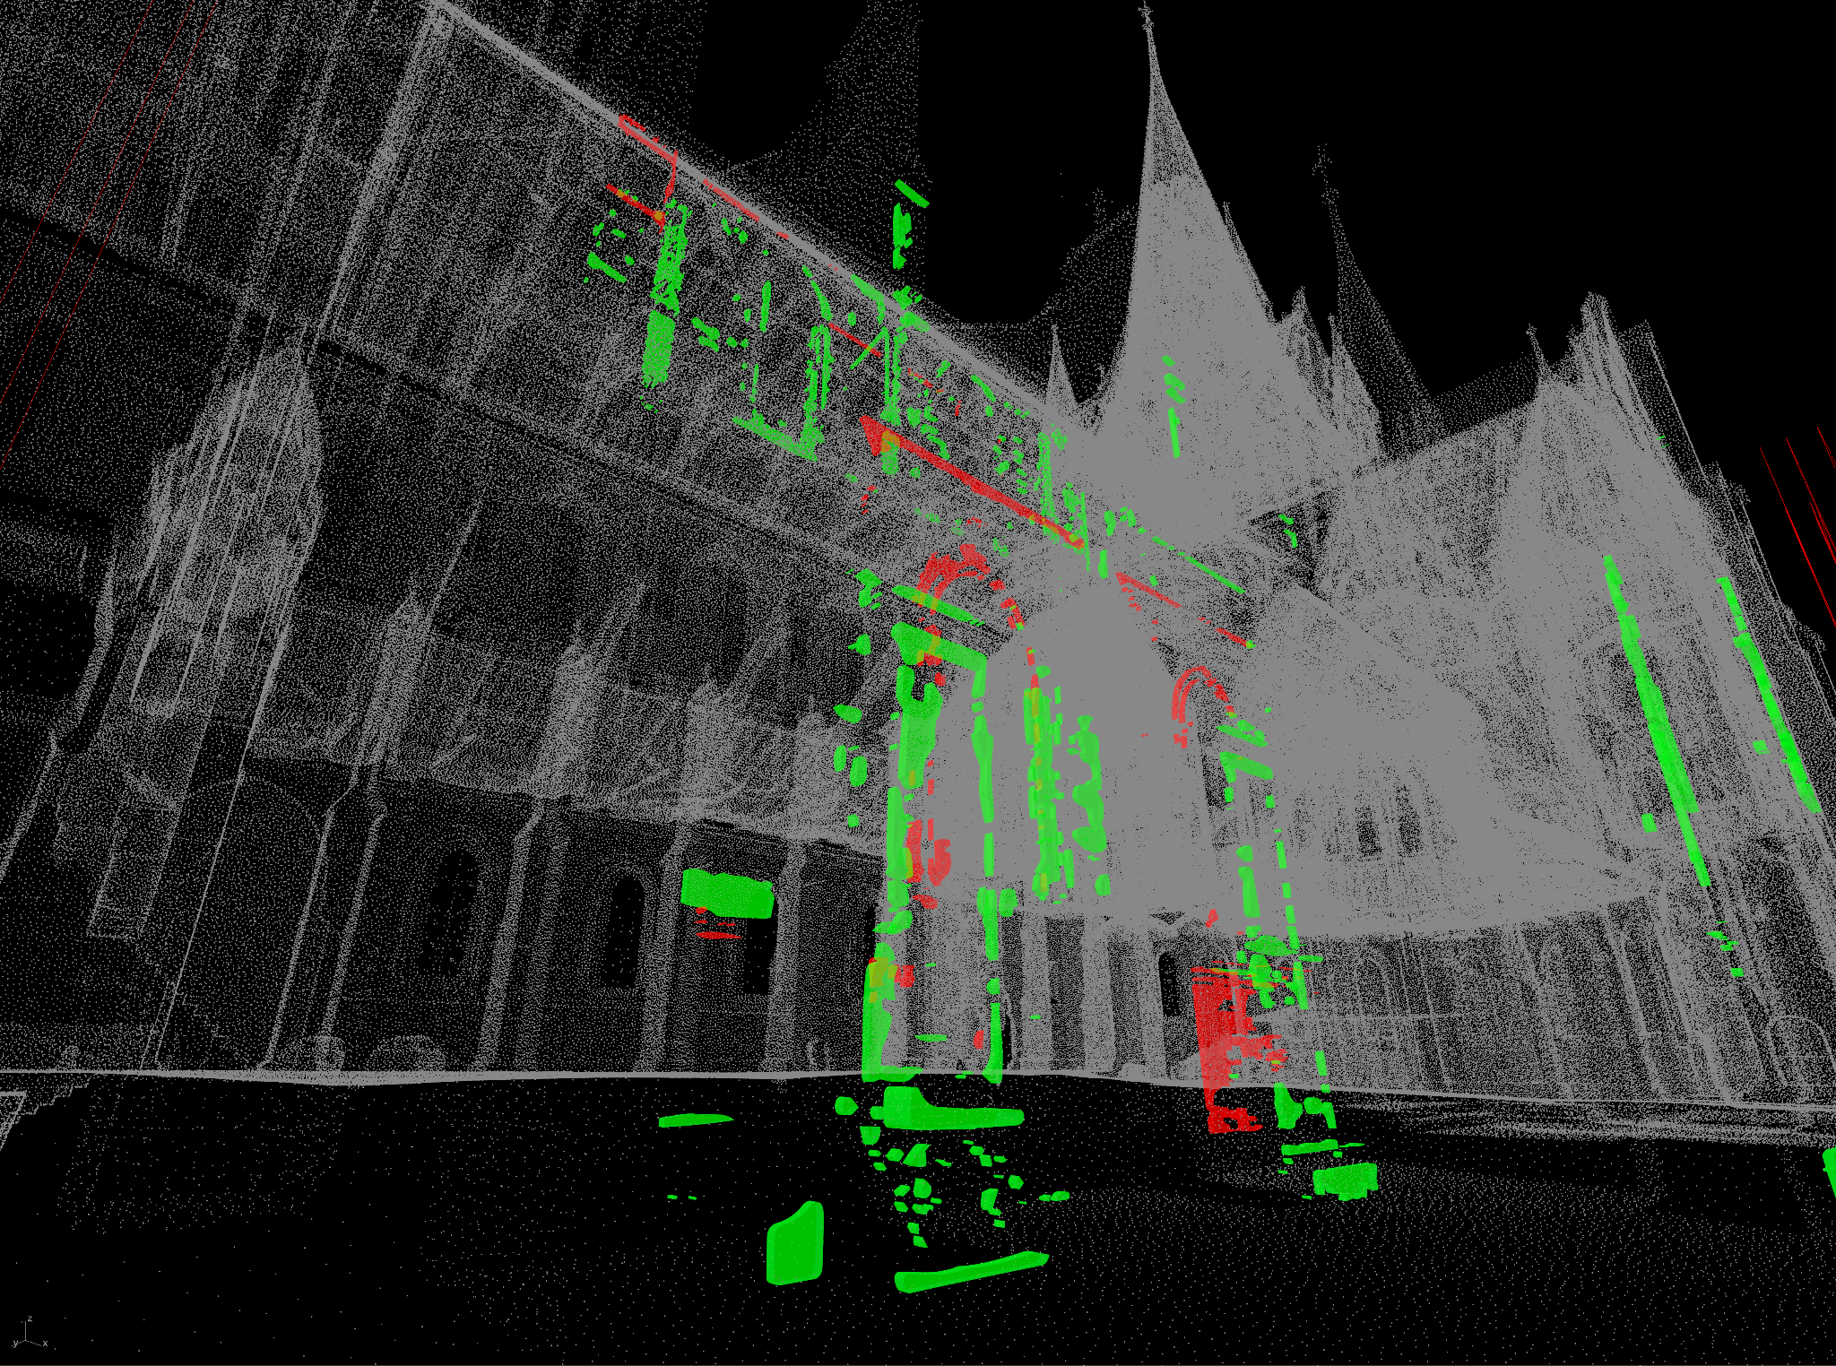


English ▼
Molasse Sandstone
Interactive Tour
Our App « Molasse @ Lausanne » allows you to:
Identify where different stones were used
Find out their type and age
Test your knowledge with an interactive game
For this, click on « Download the App »
To get instructions , Click on « Get instructions »
Download the App
Get instrucations
Back
Image credit

